Slide 1
Energy Management System
The Web Application

Slide 2
Overview
Display energy usage statistics
Naming/Grouping of outlet modules
Scheduling (on/off) of outlet modules
Server stuff
Database stuff
Focus on usability and look

Slide 3
Marketing Requirements
The system shall allow for control of individual outlets.
The system shall provide intuitive visual representations of usage data.
The system shall have low cost in comparison to competitive products.
The system shall be easy to install by a professional.
The system shall have an easy to use interface.
The system shall be of reasonable size in comparison to existing systems.
The system shall consume minimal power.

Slide 4
Embedded Platform
Product | Raaspberry Pi 2 Model B+ | BeagleBone Black Rev. C
Price | $35 | $55
Size | 3.370" x 2.224" | 3.4" x 2.15"
Processor | Broadcom BCM2836 | AM3358BZCZ100
Cores | 4 | 1
Clock Speed | 900 MHz | 1 GHz
RAM | 1 GB | 512 MB
Onbaord Flash | None | 4 GB
External Storage | microSD | microSD
Operating Voltage | 5V | 5V
Power | 230 - 800 mA | 210 - 460 mA
Digital GPIO | 40 | 65
Analog Inputs | None | 7
I2C | Yes | Yes
SPI | Yes | Yes
Ethernet | 10/100 RJ45 | 10/100 RJ45
USB | 4 | 1
Video Out | HDMI | micro HDMI
Price
Amount of memory (RAM)
Power consumption
Ease of use (subjective)
Raspberry Pi 2

Slide 5
Server/Framework
Overhead (Memory Usage)
Language
Ease of Setup (subjective)
Setup | Apache Tomcat | Django on Apache | HTML/JavaScript on Apache
Idle Memory Consumption | ~150 MB | 20-30 MB | ?
Language | Java | Python | HTML/JavaScript/PHP/Python
Ease of setup (5 = easiest) | 3 | 2 | 5
Django?

Slide 6
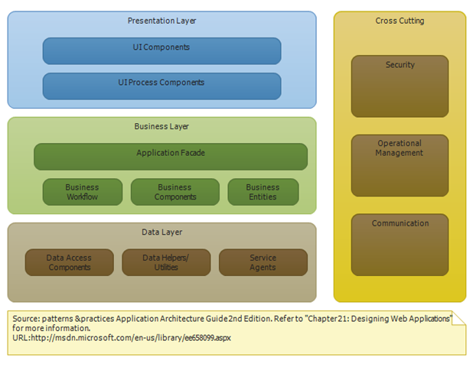
Design

Slide 7
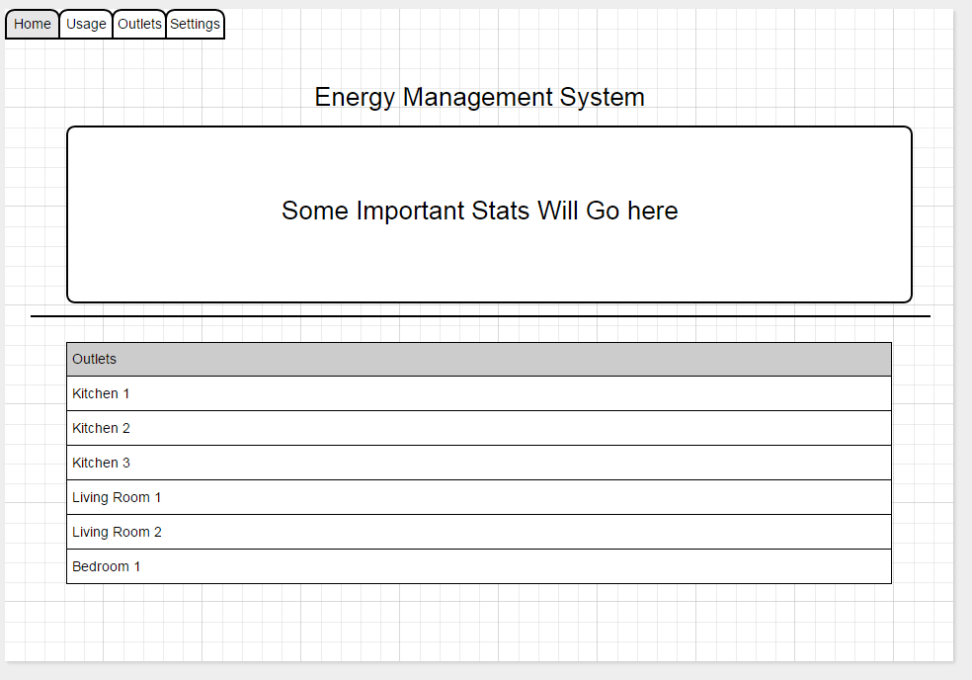
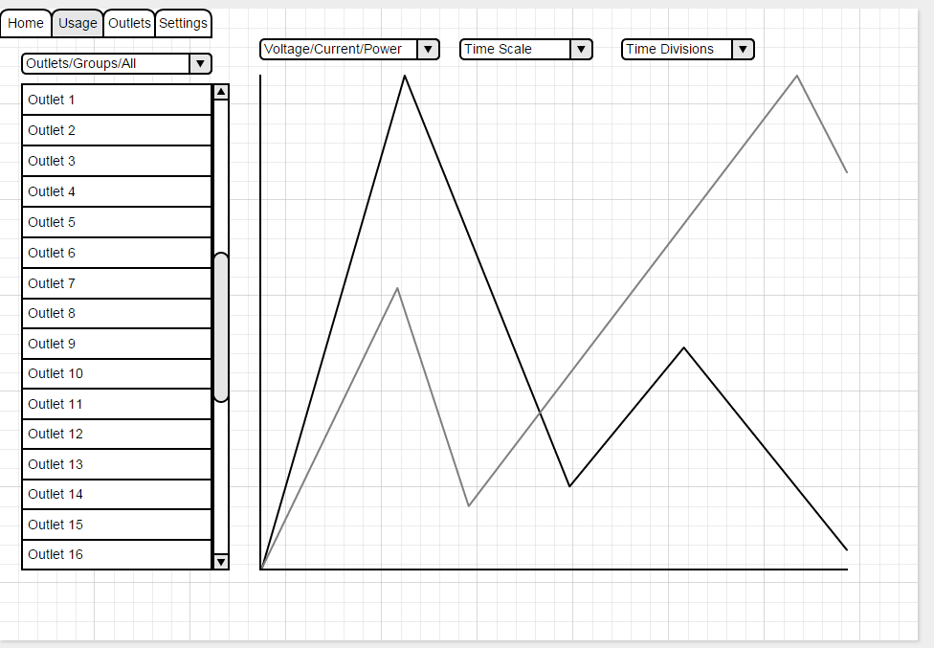
UI Mockup

Slide 8
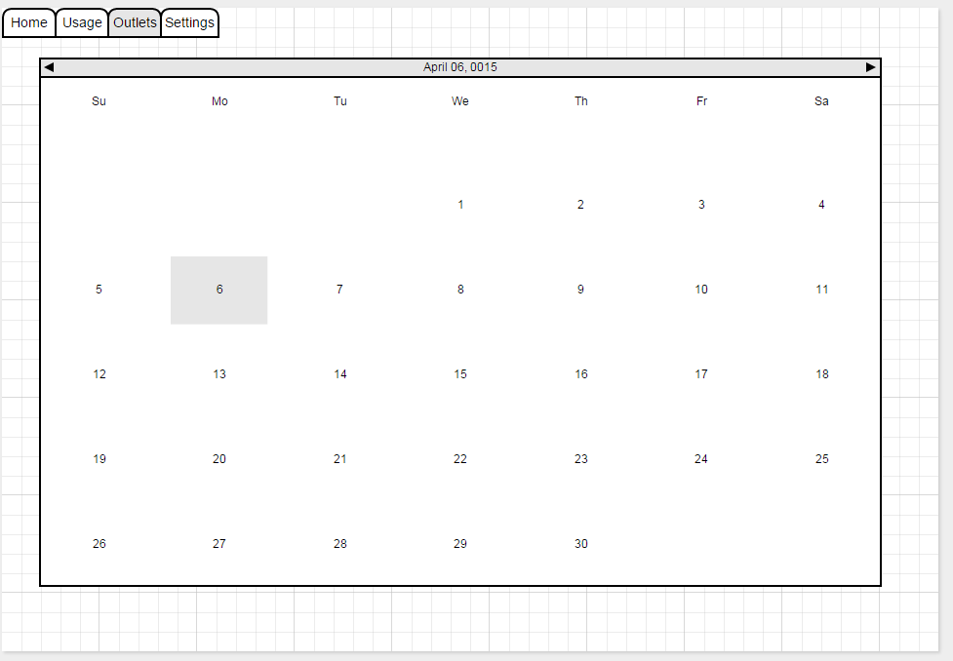
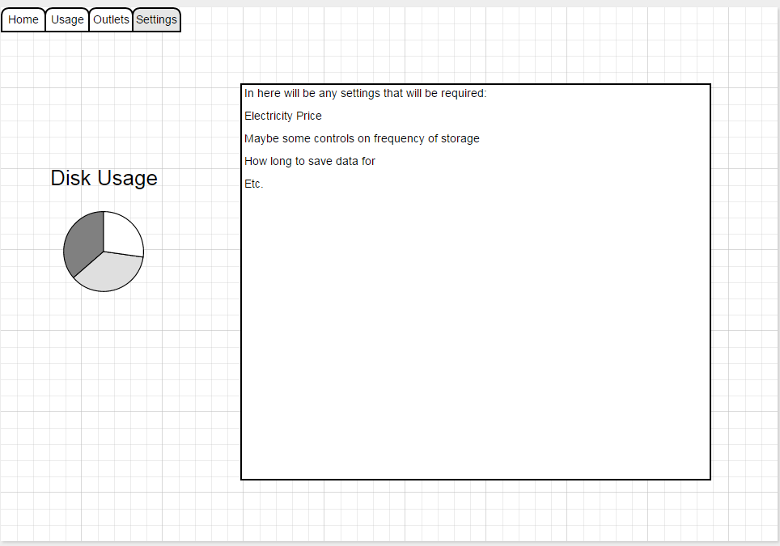
UI Mockup cont.

Slide 9
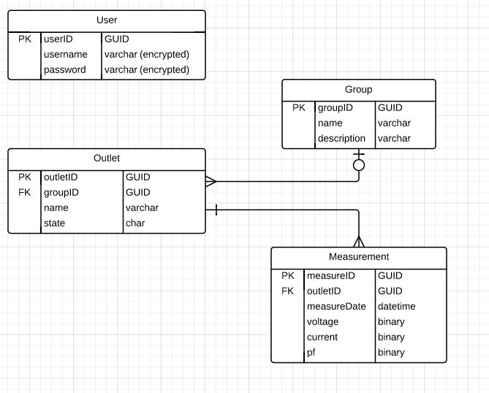
Database
Application Users
Outlet Modules
Groups
Measurements
Other Things
Settings
UI State
Etc…

Slide 10
Testing
Use software testing strategy that we all know and love…
Focus on functionality and usability
External Usability Tests
Components
Security/Login
Naming and Grouping
Charts
Scheduling
Database Things
Hardware Interface

Slide 11
Uncertainties
Raspberry Pi Performance
Memory Usage
Processing Power
Django
Unfamiliar
Enough Functionality?
Setup Time
Time…

Slide 12
Questions??

